Slide 1
Quiz masters
Course: Introduction to Programming Project: Blackjack in C++

Slide 2
Content
Our team
It shows the members of our team
01
Our idea
02
It shows our idea
Planning stages
03
It shows how we planned things for the project

Slide 3
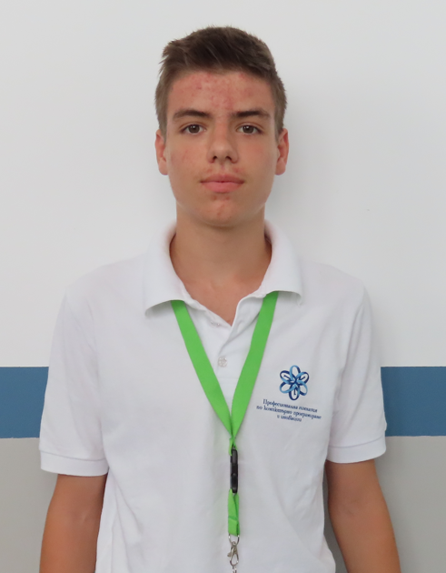
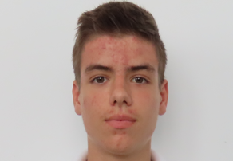
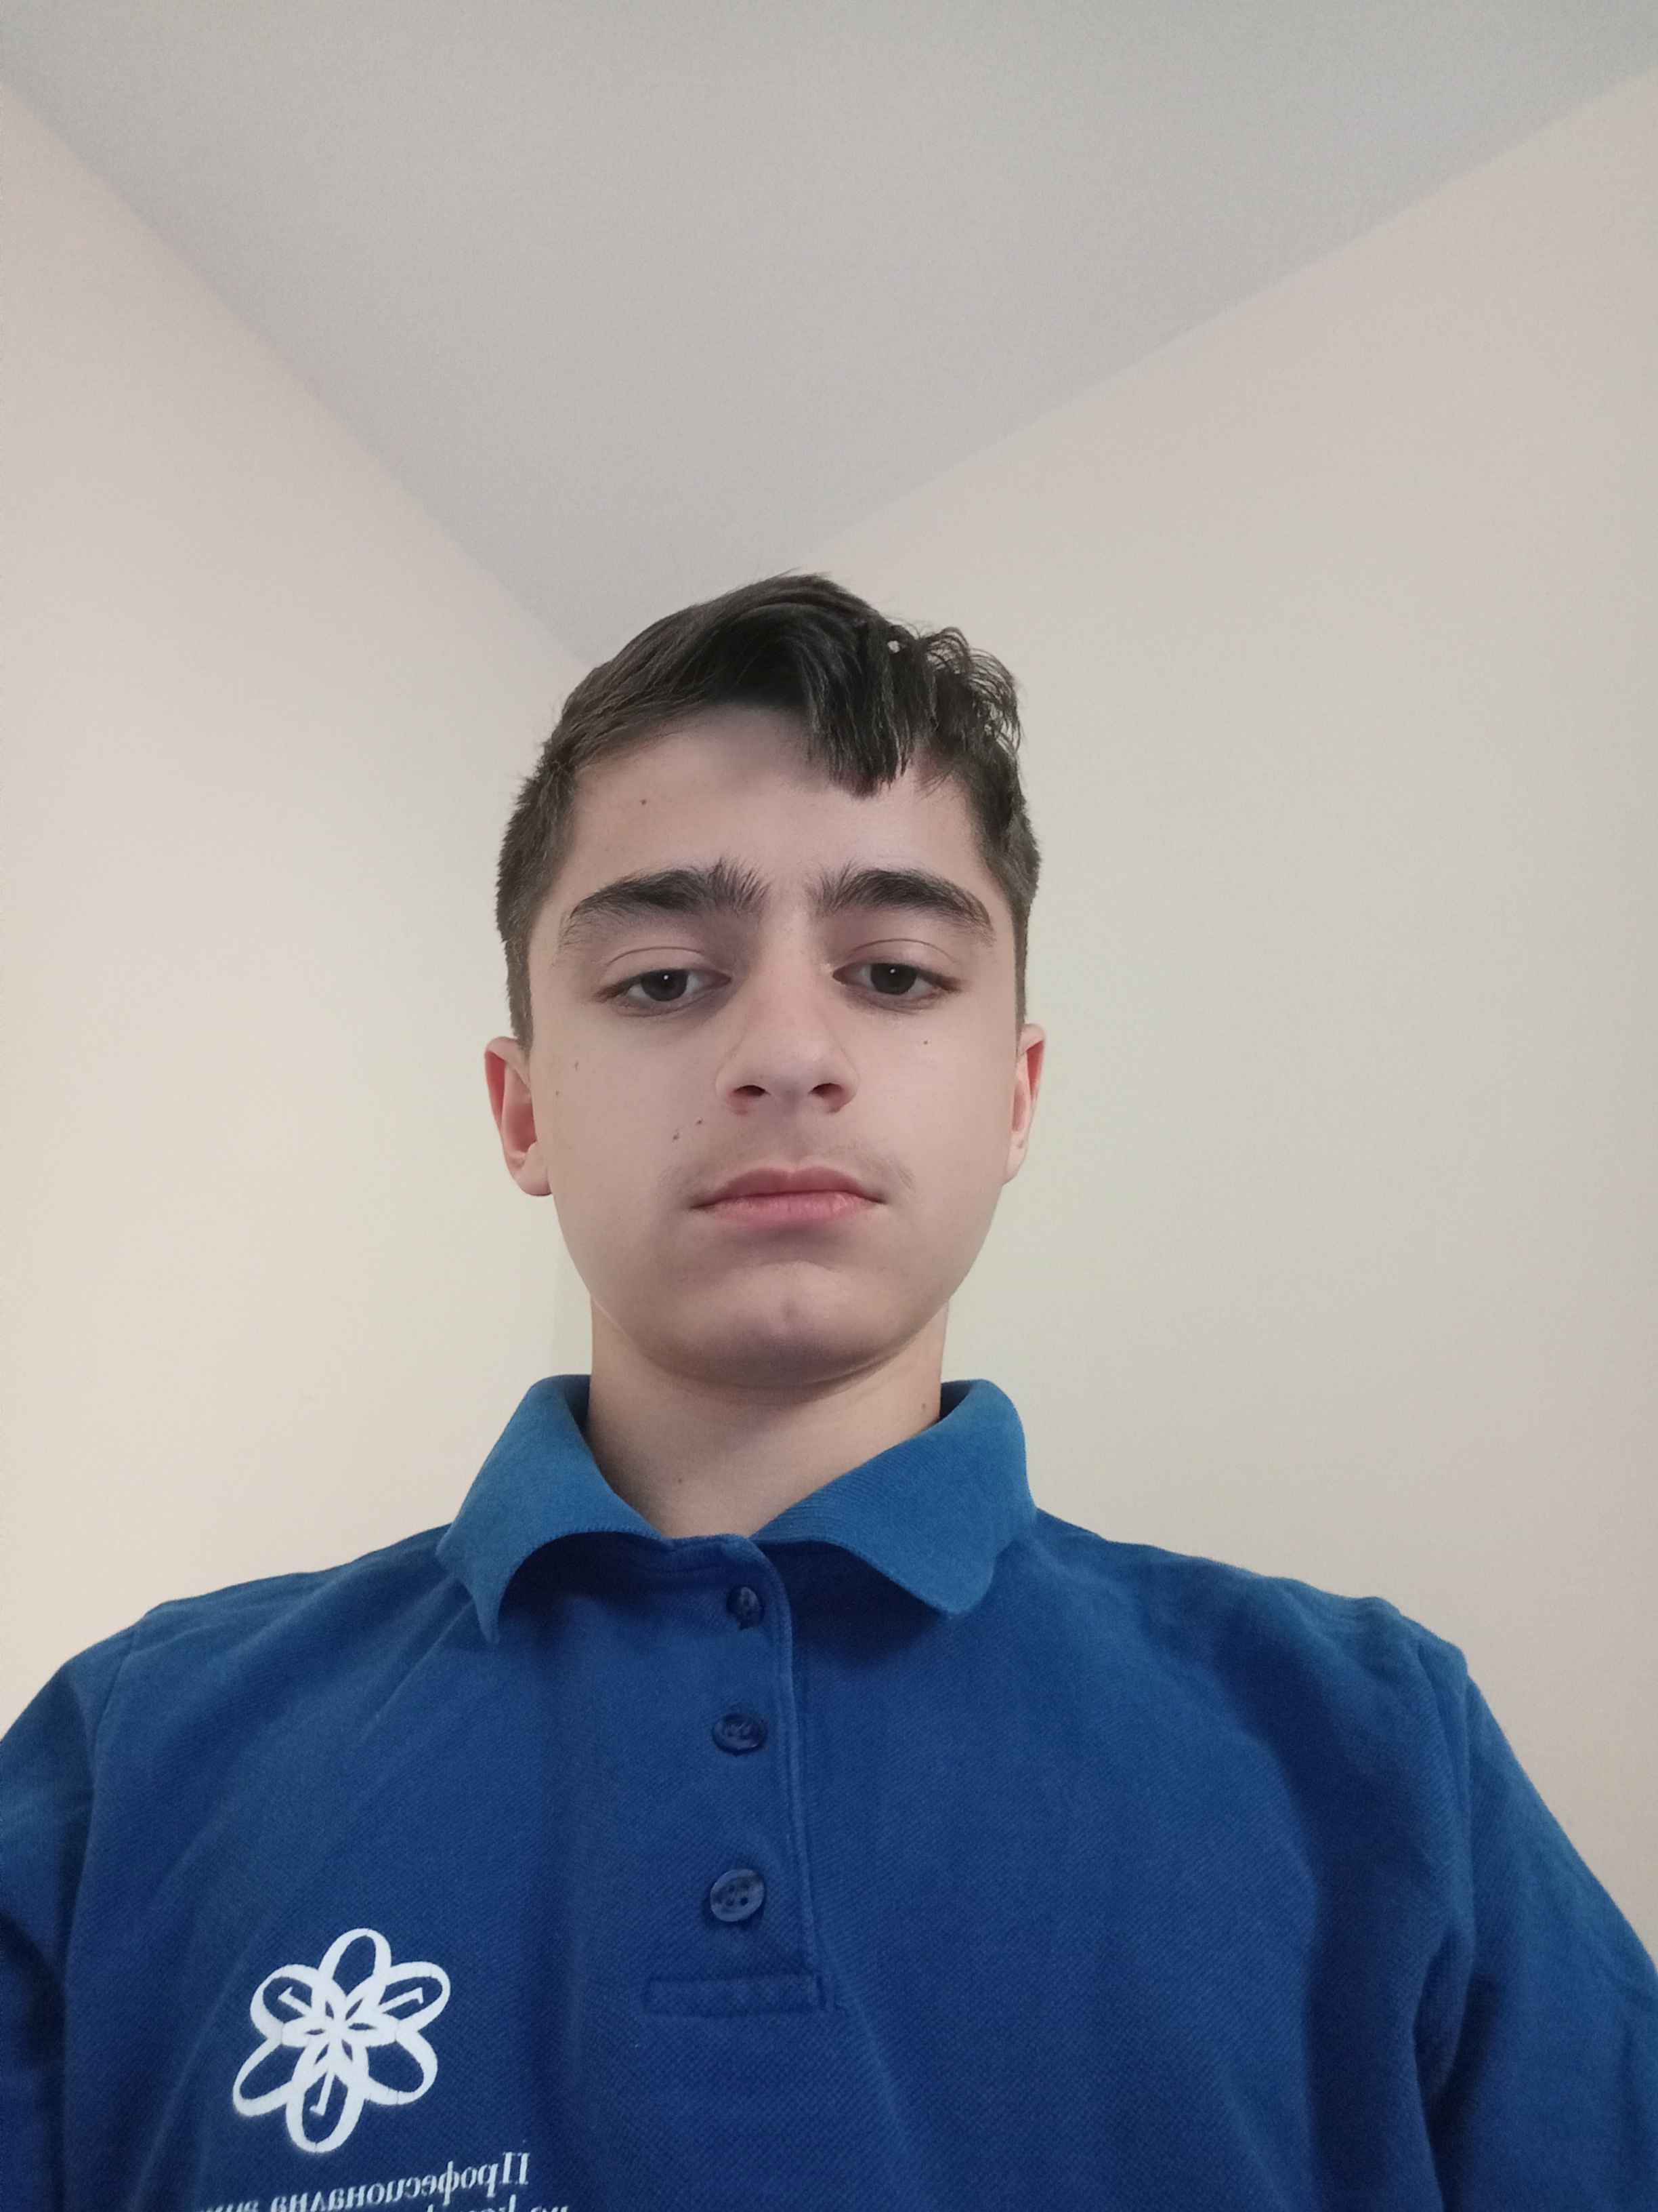
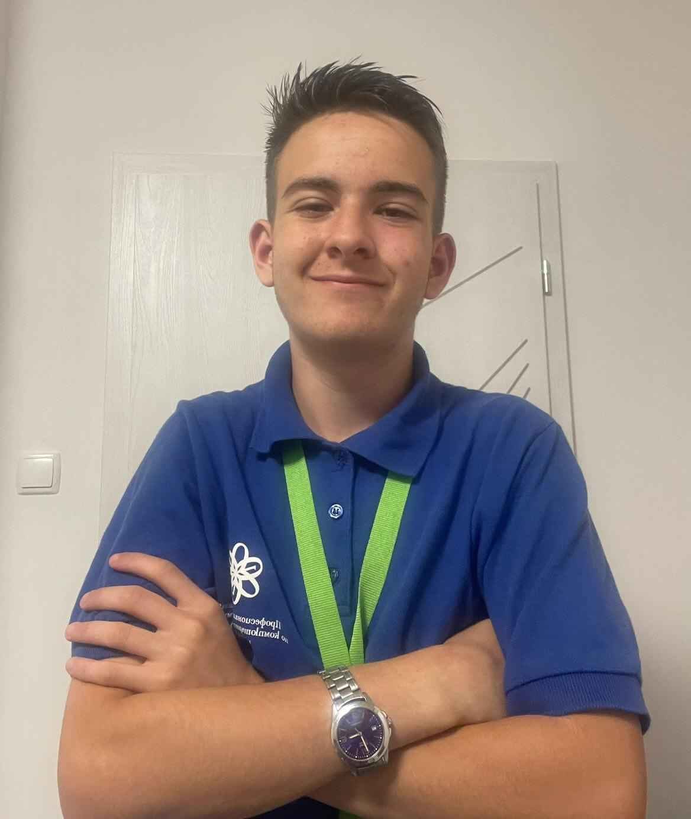
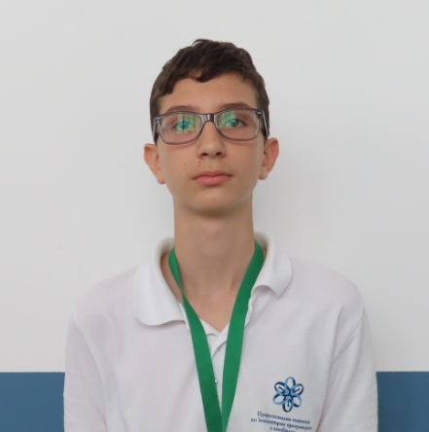
Memebers
MMTsonkov23
Stoyan Vassilev
VictorNikolov
SATomov23

Slide 4

Our idea
Our idea is to create blackjack in which you will need to do math problems to see how much points is your card

Slide 5
Planning stages
Creating our team
Making our
idea
Making our
project
Presenting

Slide 6
Now lets move to our game

